Slide 1



2024 Single Cell Workship Colombia: Day 2 Honeycomb Processing and 10X Probe Hybridization
July 15-19, 2024
Bogota, Colombia

Slide 2
Objectives for Today
Honeycomb CLX
10X Genomics
Seal honeycomb hives for polyA capture
Lyse and hybridize HIVES
Recover beads from HIVES
Synthesize 1st stand CDNA
Synthesize 2nd strand of cDNA
Perform Whole Transcriptome Amplification (WTA)
Hybridize fixed nuclei and cells with 10X Fixed RNA Profiling Probes

Slide 3

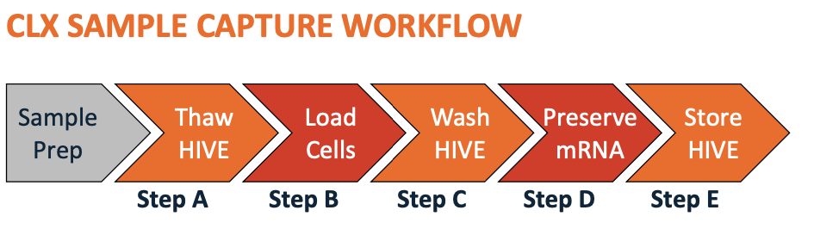
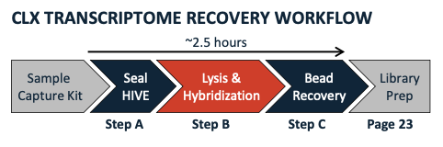
Honeycomb CLX Overview
~ 30 min
Yesterday
Today
Notes:
For honeycomb today, we will be loading the HIVES to capture the poly-A transcripts of our nuclei and cell lines, and then we will go through a series of steps to seal the HIVE membranes, lyse the cells/nuclei, and recover the beads containing the transcripts for first strand synthesis.

Slide 4
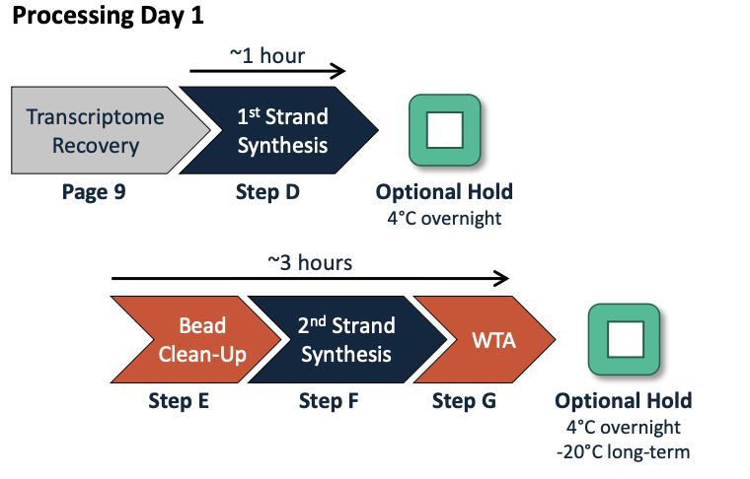
Honeycomb CLX Recap + Next Steps
Notes:
Recap: We did sample capture, transcriptome recovery, and 1st strand synthesis.

Slide 5
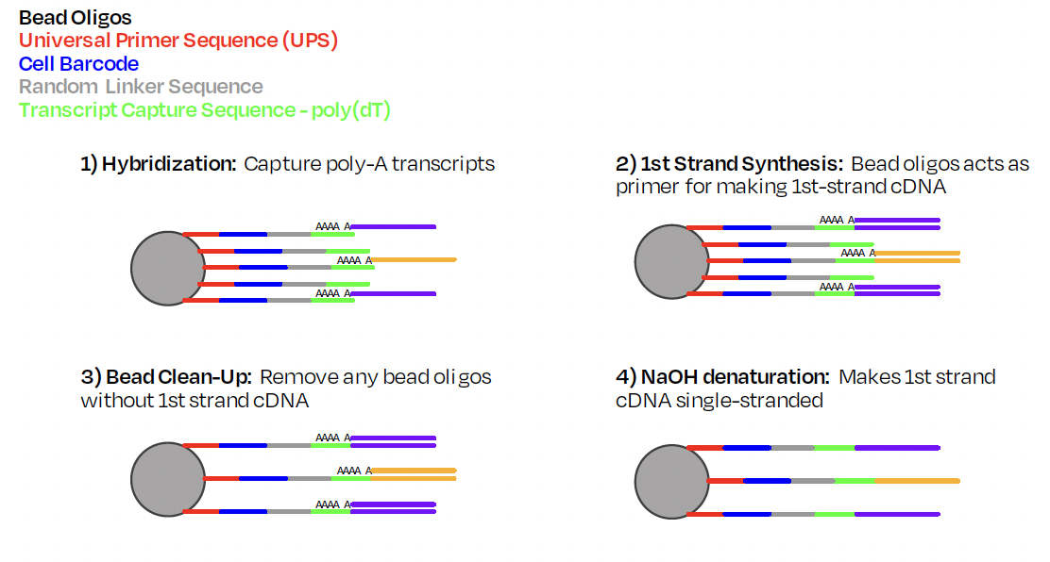

Slide 6
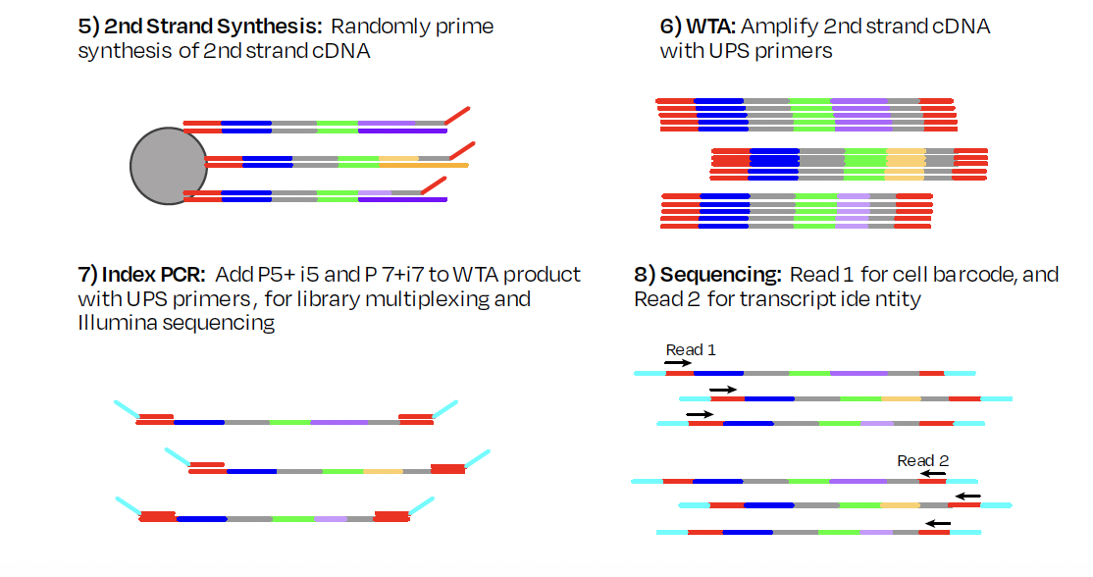

Slide 7
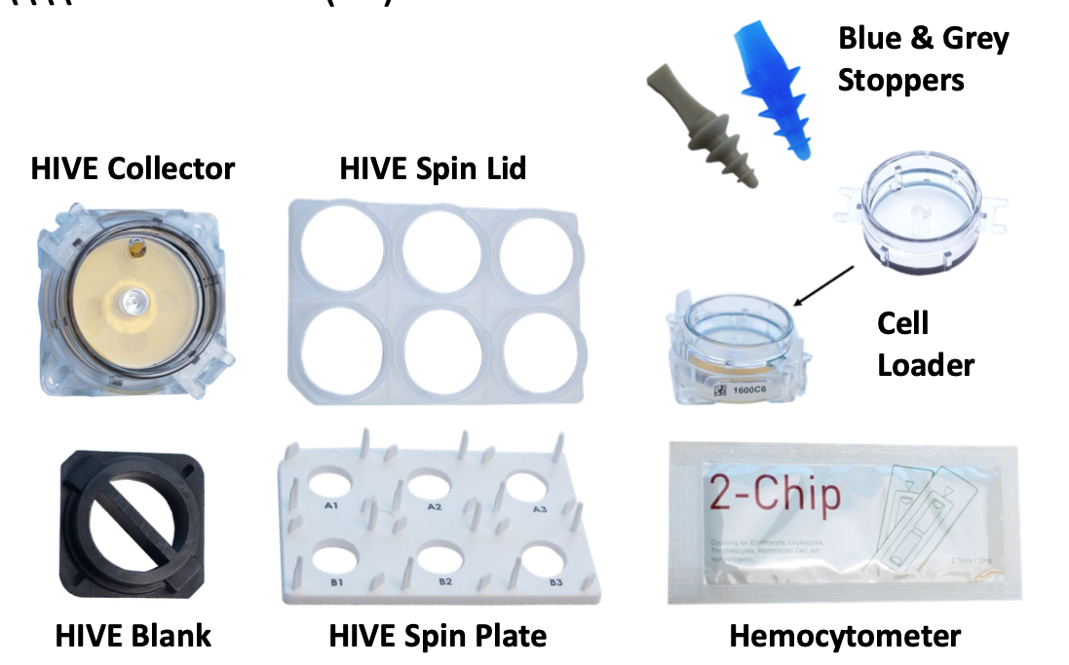
Honeycomb CLX Contents
Notes:
This is the general process for many high-throughput single cell RNA sequencing workflows. Beginning with some heterogeneous sample, we remove DNA, protein, and cellular debris in order to isolate mRNA. The mRNA is reverse transcribed and barcoded resulting in a cDNA library. The prepared library is sequenced, yielding millions of reads(or genes) which need to be mapped to a reference genome. The final result is an expression matrix of cells and genes that can be further analyzed. The main point of difference for many of the high-throughput methods is how the barcoded library is generated.
_______________
Before the emergence of scRNA-seq technology, RNA was profiled using Bulk RNA sequencing, which provides an average expression profile of all the cells in the sample. However, single-cell RNA sequencing can break down the spectrum by enabling the dissection of gene expression at the single cell level.The cDNA product is subsequently amplified by PCR. The amplified whole transcriptome product is barcoded and tagmented to prepare a library for sequencing.

Slide 8
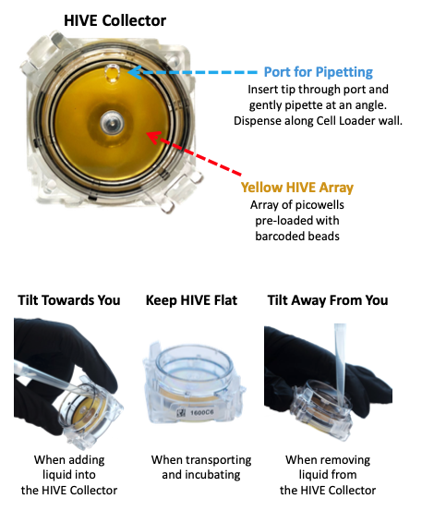
Yesterday: Honeycomb CLX Cell Loading
Notes:
This is the general process for many high-throughput single cell RNA sequencing workflows. Beginning with some heterogeneous sample, we remove DNA, protein, and cellular debris in order to isolate mRNA. The mRNA is reverse transcribed and barcoded resulting in a cDNA library. The prepared library is sequenced, yielding millions of reads(or genes) which need to be mapped to a reference genome. The final result is an expression matrix of cells and genes that can be further analyzed. The main point of difference for many of the high-throughput methods is how the barcoded library is generated.
_______________
Before the emergence of scRNA-seq technology, RNA was profiled using Bulk RNA sequencing, which provides an average expression profile of all the cells in the sample. However, single-cell RNA sequencing can break down the spectrum by enabling the dissection of gene expression at the single cell level.The cDNA product is subsequently amplified by PCR. The amplified whole transcriptome product is barcoded and tagmented to prepare a library for sequencing.

Slide 9

Honeycomb CLX Membrane Sealing

Slide 10
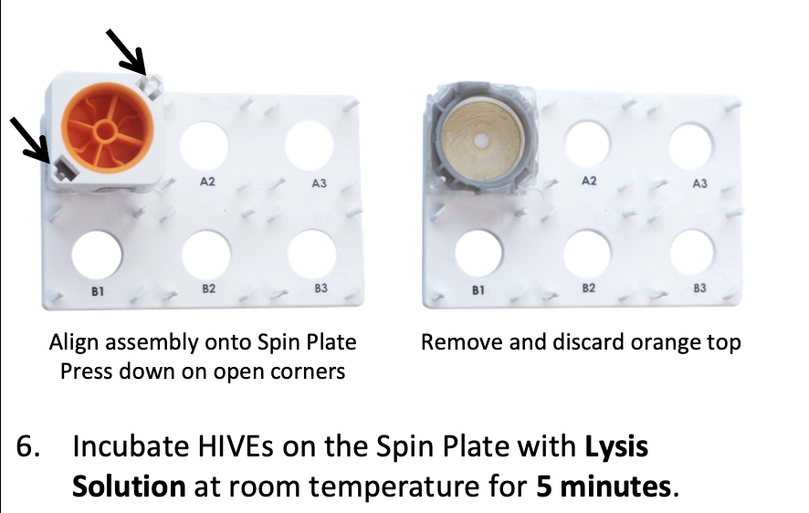
Honeycomb CLX Cell Lysis and
Hybridization
Lysis
Hybridization Buffer
Washes
Notes:
This is the general process for many high-throughput single cell RNA sequencing workflows. Beginning with some heterogeneous sample, we remove DNA, protein, and cellular debris in order to isolate mRNA. The mRNA is reverse transcribed and barcoded resulting in a cDNA library. The prepared library is sequenced, yielding millions of reads(or genes) which need to be mapped to a reference genome. The final result is an expression matrix of cells and genes that can be further analyzed. The main point of difference for many of the high-throughput methods is how the barcoded library is generated.
_______________
Before the emergence of scRNA-seq technology, RNA was profiled using Bulk RNA sequencing, which provides an average expression profile of all the cells in the sample. However, single-cell RNA sequencing can break down the spectrum by enabling the dissection of gene expression at the single cell level.The cDNA product is subsequently amplified by PCR. The amplified whole transcriptome product is barcoded and tagmented to prepare a library for sequencing.

Slide 11
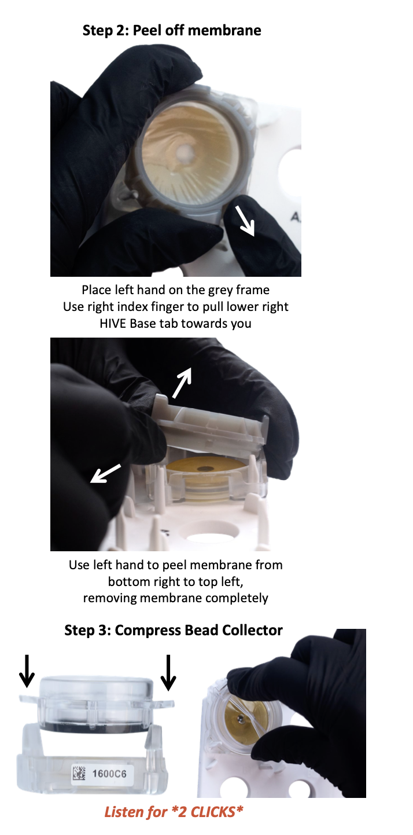
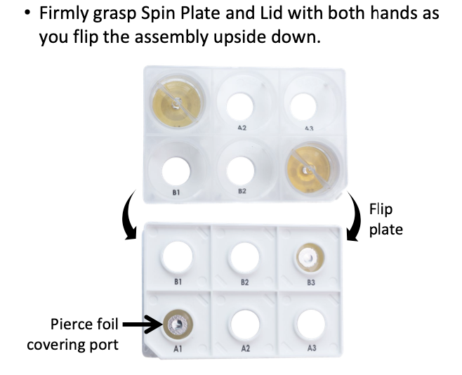
Honeycomb CLX Bead Recovery
We will peel off the membrane and expose it completely
By centrifugation, we will recover the beads containing our transcripts!
Notes:
For

Slide 12
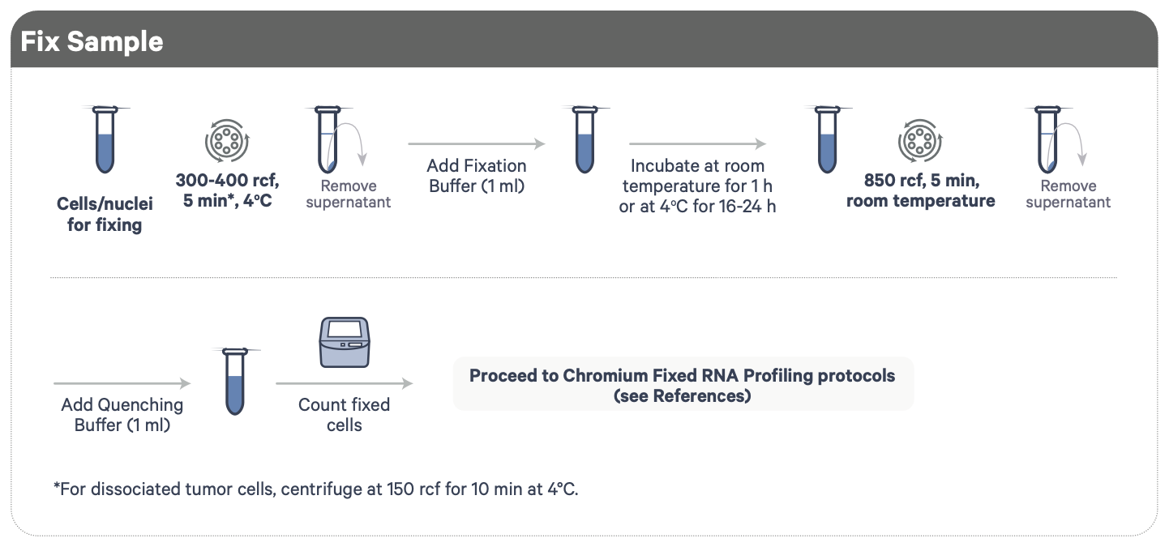
10X Fixing Cells Recap
Day 1
Day 2
Post nuclei isolation
Demonstrated Protocol | Fixation of Cells & Nuclei for Chromium Fixed RNA Profiling
Notes:
We’ll be taking advantage of a fixation protocol for processing our cells and nuclei. We spin down our cells/nuclei and treat them with a fixation buffer, which contains a mild detergent to help permeabilize the sample as well as formaldehyde which involves in cross-linking of proteins to preserve the biological state of our samples and prevent degradation.
IMPORTANT: Formaldehyde must be used under a fume hood with proper ventilation!
After fixation, we spin down again and replace with quenching buffer to inactivate the fixation as prolong fixation can very much affect sample quality.

Slide 13
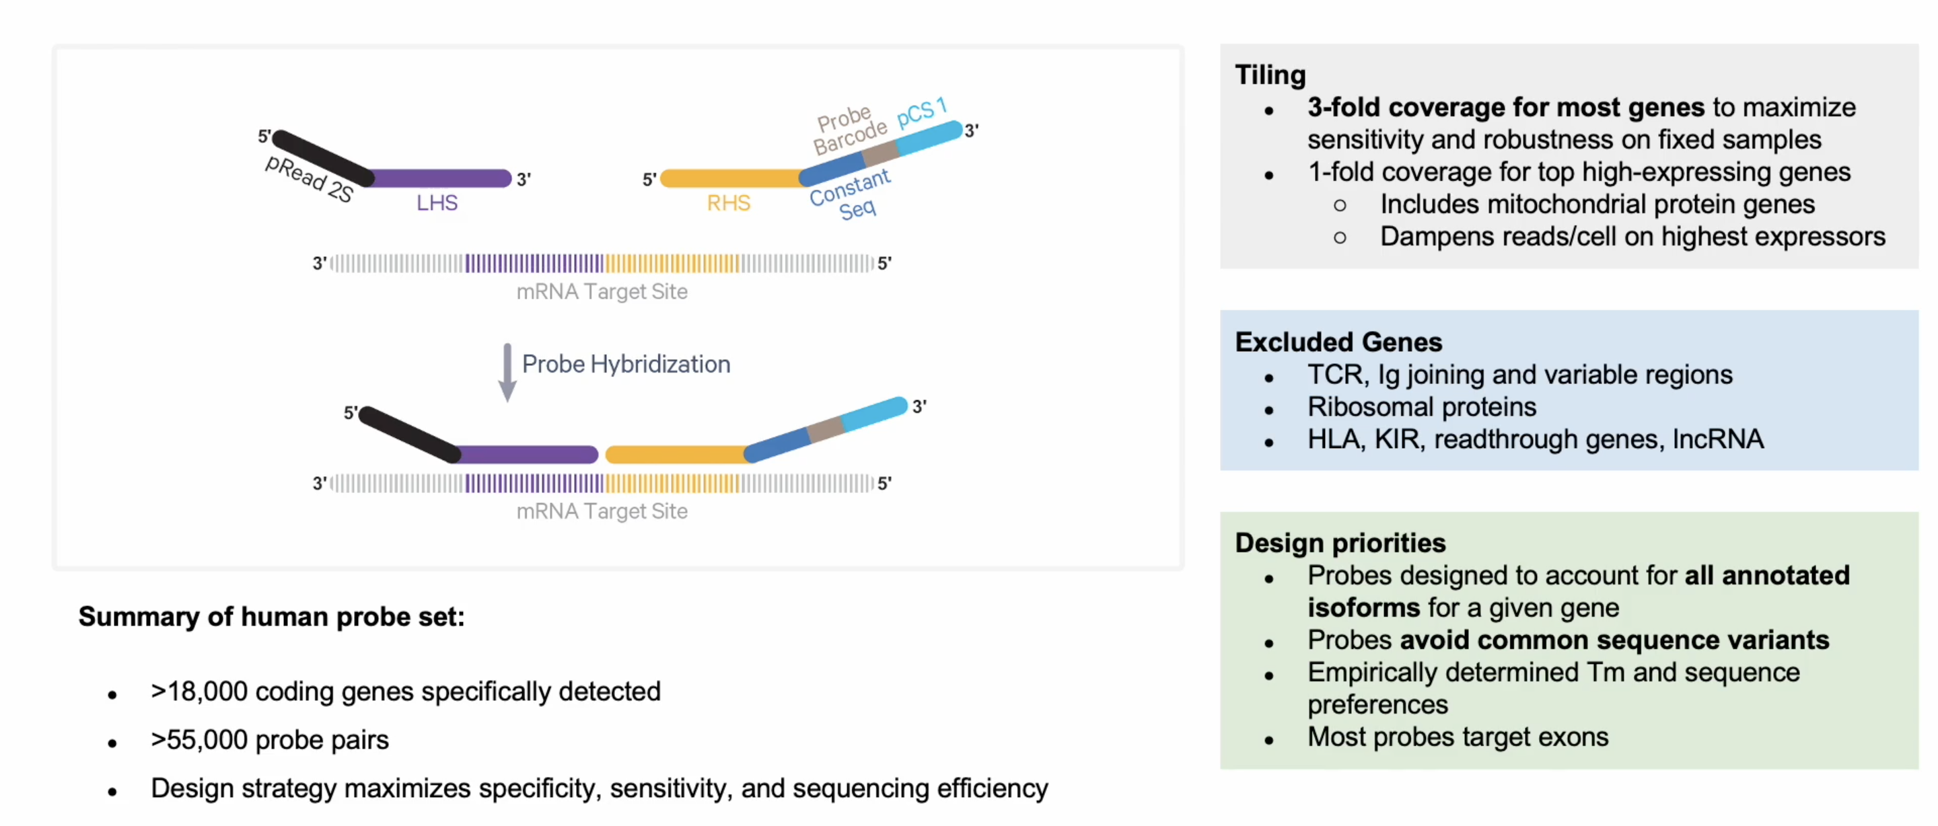
Chromium Fixed RNA Profiling–Probe Hybridization
10X Genomics Fixed RNA Assay
Notes:
In traditional 10X assays, transcripts are captured either at the 3’ end (via polyA capture), or the 5’ end. But because fixation can lead to sample RNA degradation, we want to only capture RNA molecules of interest, so the probes are specifically designed to bind to complementary RNA of target sites from both the 3’ and 5’ region.
The probes bind to adjacent sites on their target transcripts, are then ligated together, and then become the substate for library construction further down the line.
The 10X probes are highly sensitive and allow for 3-fold coverage of most genes, however, one drawback is that these probes are very specific, so several genes include those for TCR, or lncRNA might be excluded, therefore a specific probe set for looking at such genes will need to be designed (costly) .

